Slide 1
Police patrolling system
By team Arya

Slide 2
NEEDS
111
1)In India police patrolling is not going the way it should have been gone
2)As when vehicles are allocated to police officers either of doing their duty they are using them for their own personal purpose
3)Due to these corrupted officers India is lagging behind
4)So with the help of this police patrolling system we can know their location and can do monitoring on them

Slide 3
What police can do
Know the location of police vehicle
Know distance from nearest police station in range of 1000 meters
Automatic check whether they are on right track on not and give an alert when track is taken wrong

Slide 4
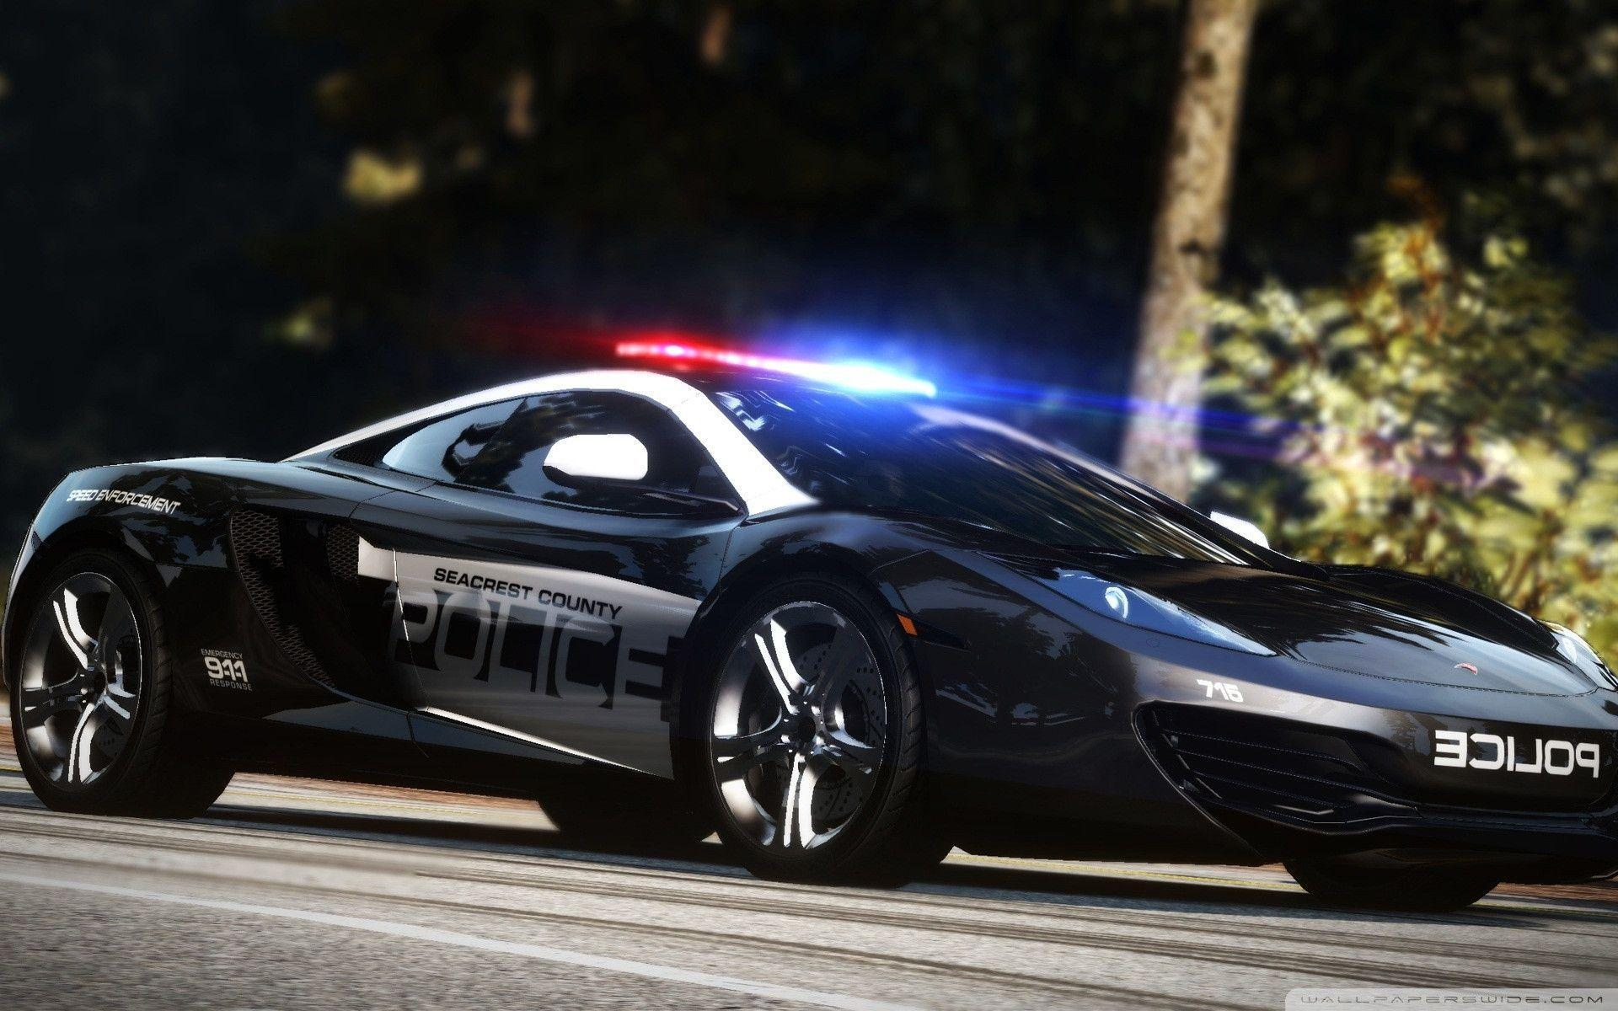
Benefits 1)police server can know their vehicle location 2)If our officers are not able to contact us then we can easily contact them and can provide backup if required 3)patrolling will go in its right way
Disadvantage
1)If the system is not fully secure then hacker will easily access this system and can know there location and can use benefit of this system or attack them

